Slide 1

SREENIDHI INSTITUTE OF SCIENCE And TECHNOLOGY (An Autonomous Institution Approved by UGC) Yamnampet, Ghatkesar, R.R. District -501301 Department of COMPUTER SCIENCE AND ENGINEERING
A Group Project Design seminar on AUTOMATED ENTRY MANAGEMENT WITH SUSPICIOUS PERSON TRACKING
By
V. Raghu Ram (21311A05E0)
J. Bhojeshwar (21311A05E2)
Md. Rahmath (21311A05G1)
Project Guide Head of the Department
P .Veer Kumar Dr Aruna Varanasi
Assistant Professor Professor & HOD
CSE CSE

Slide 2
Contents
Architecture
UML Diagrams and Representations
Interface Design
References

Slide 3
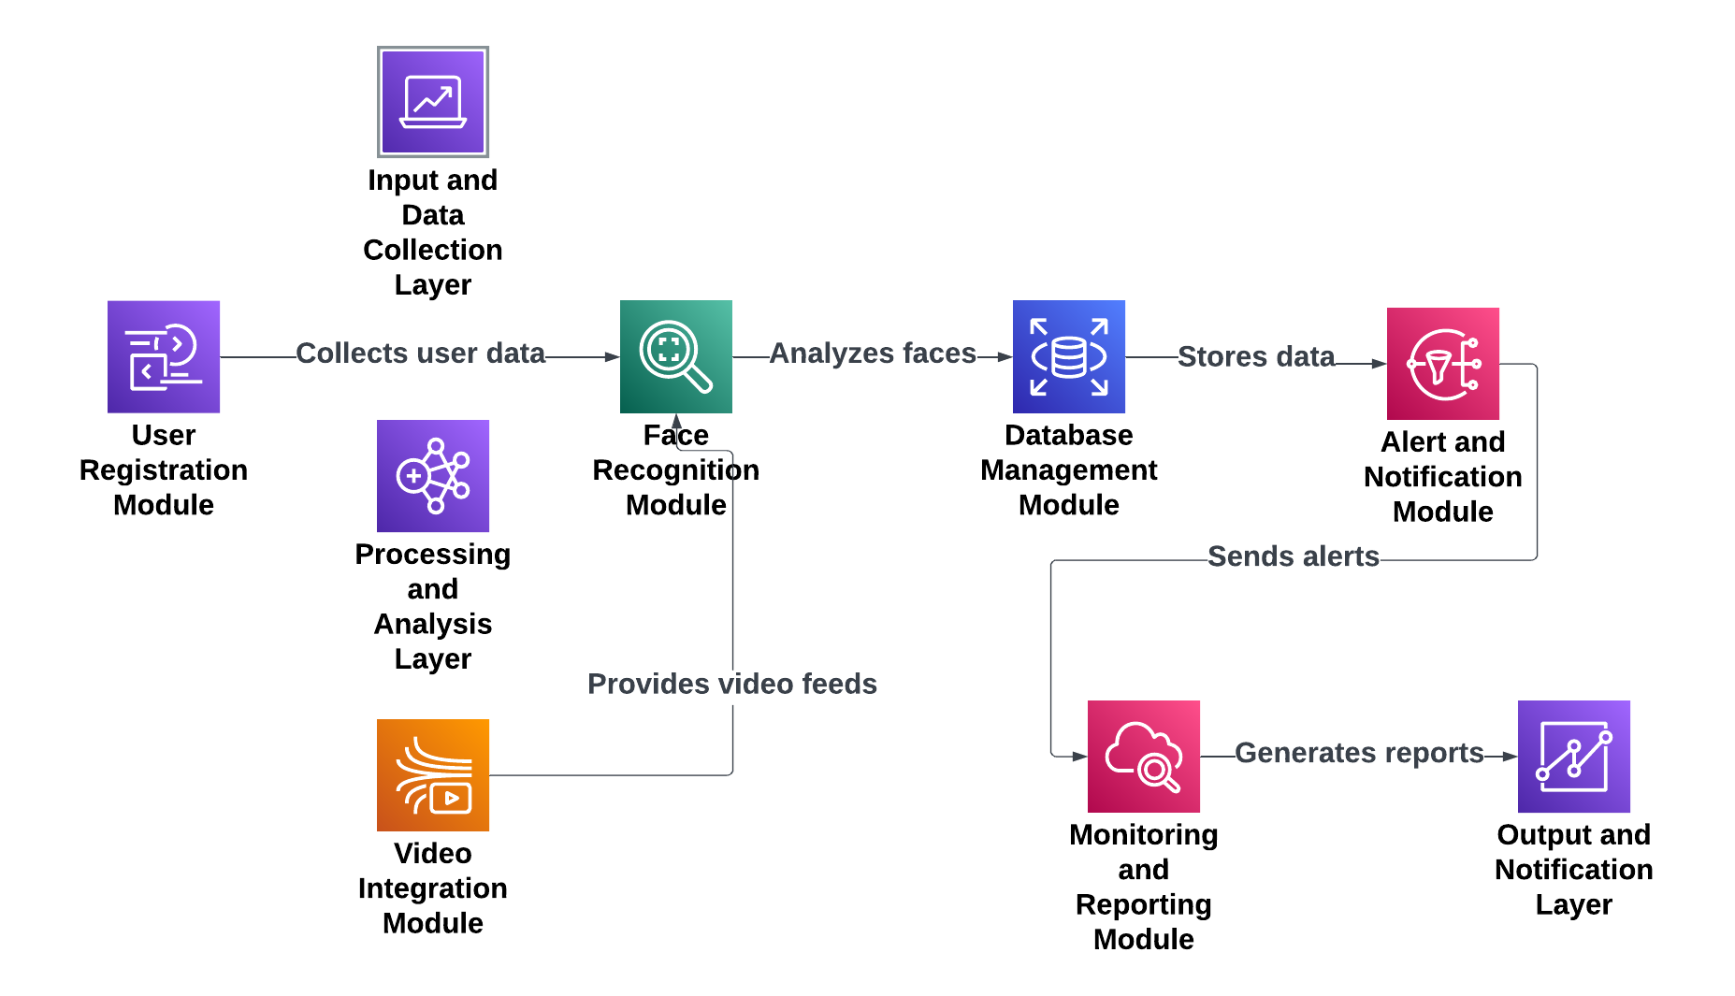
Architecture

Slide 4
Architecture Diagram
Input and Data Collection Layer
User Registration Module: Registers individuals with facial data, basic details, and classifications (authorized, suspicious, blacklisted).
Video Integration Module: Captures live or recorded video feeds, converting them into frames for processing.
Processing and Analysis Layer
Face Recognition Module:
Detects faces in video frames.
Matches faces with profiles in the database.
Classifies individuals as authorized, suspicious, or blacklisted.
Database Management Module: Stores user profiles, detection logs, alert histories, and real-time monitoring data.
Output and Notification Layer
Alert and Notification Module: Sends real-time alerts (email/SMS) with details, timestamps, and optional frame captures for suspicious or blacklisted individuals.
Monitoring and Reporting Module: Provides dashboards, logs, and statistical reports for incident tracking and system performance evaluation.

Slide 5
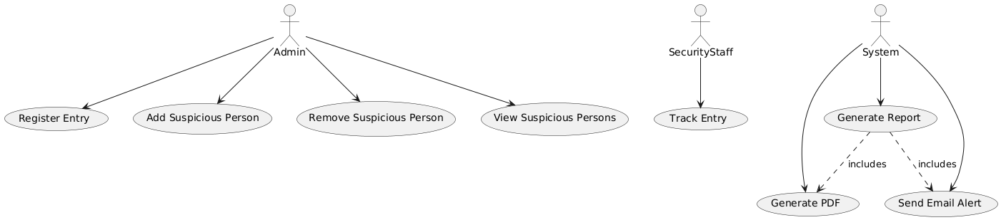
UML Diagrams and Representations
Use Case Diagram

Slide 6
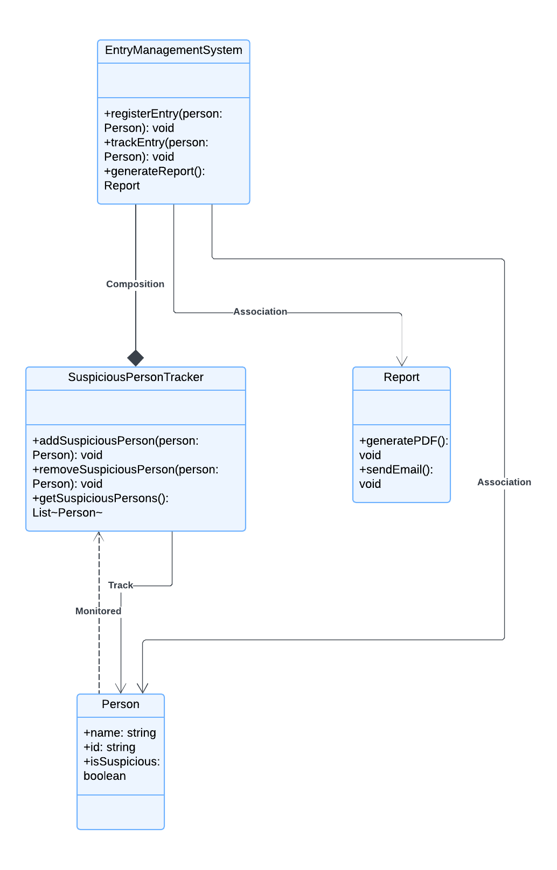
Class Diagram

Slide 7
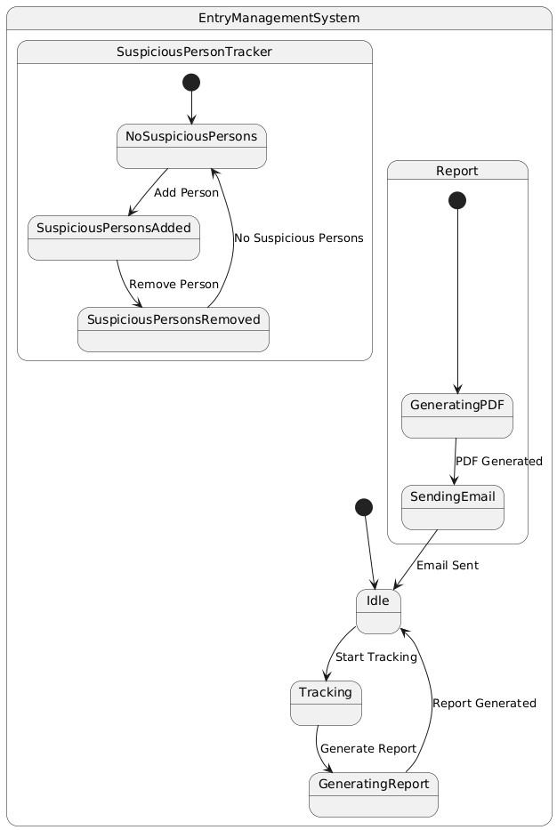
State Diagram

Slide 8
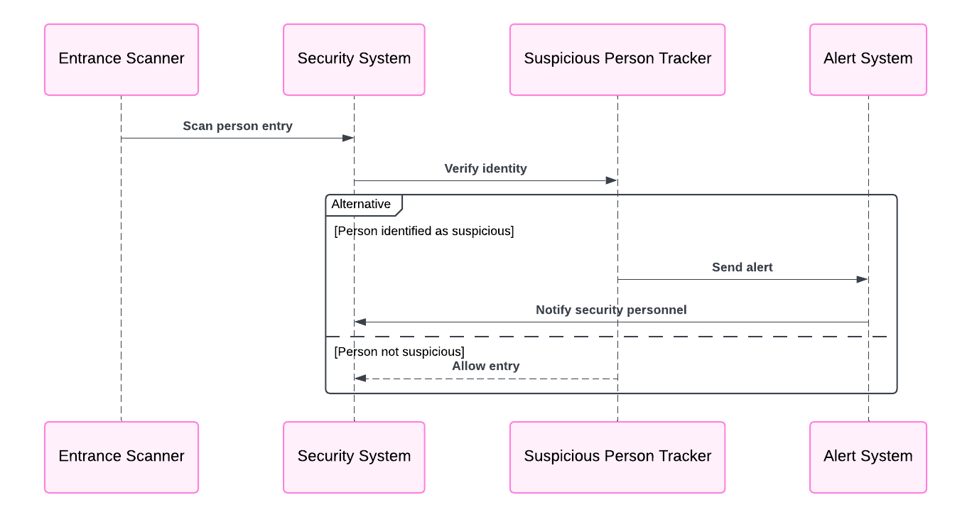
Sequence Diagram

Slide 9
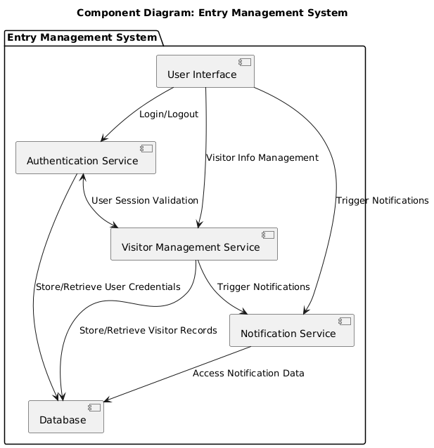
Component Diagram

Slide 10
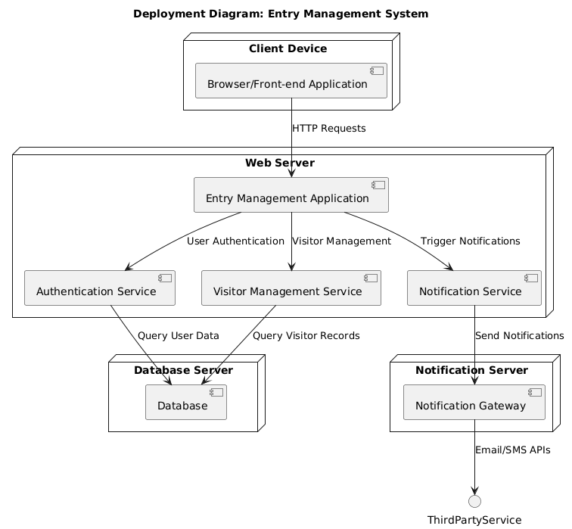
Deployment Diagram

Slide 11
Thank you

